Slide 1
Forest Assisted Migration Project Family Kit

Slide 2
What we did.
We created an educational booklet that can be given to people who have purchased a seedling or seedlings from the Forest Assisted Migration Project. This booklet can also help someone decide which type of seedling to purchase, and then how to care for it. It also includes educational activities for families and children to help inspire an appreciation and stewardship of trees and forests in future generations.
The Forest Assisted Migration Project (FAMP) works to help Minnesota’s Northwoods prepare for and adapt to environmental changes caused by climate change.
The booklet includes:
Introduction and explanation of FAMP and “climate forward” trees
Quick reference chart for species sold by FAMP
General tree family facts and care information
Educational activities appropriate for multiple age groups
Additional resources for more in-depth information from partner organizations

Slide 3
Interpretation Program support
Volunteer service categories

Slide 4
Master Naturalist skills
Explore: We explored multiple resources and tools and learned species-specific information about growing trees.
Teach: We created an interpretive booklet to teach adults and children how to successfully grow trees to help the Northwoods adapt to climate change.
Conserve: Our efforts will hopefully increase the success rate of FAMP seedlings as well as spark public awareness and action.

Slide 5
Intended audience and benefit.
Adults who have purchased seedling/s from FAMP
Parents, guardians, and educators looking to incorporate FAMP into learning opportunities for children
Adults trying to determine what climate forward tree fits their growing conditions and needs
This booklet will help FAMP customers grow their seedling successfully and assist in combating the impacts of climate change in the Northwoods. It will also provide opportunities for children to learn about and build connections with trees and the forest. This will, hopefully, instill a lifelong appreciation for the environment and inspire further stewardship across generations.

Slide 6
Sponsoring organization and benefit.
Forest Assisted Migration Project
Our “Caring for Your Climate Forward Tree Seedling” booklet will, hopefully, increase the success rate of seedlings sold by FAMP and thus increase the organization’s impact and success. The more climate forward trees that make it to adulthood, the more likely the Northwoods will be to survive the impacts of climate change. Also, if a customer has a positive experience and their tree thrives, they are more likely to repeat their purchase and recommend FAMP seedlings to others, again, increasing the number of climate forward trees planted.
Looking farther out, the included children’s educational activities can foster a life-long love and appreciation for trees, forests, and wild places. This will also increase the likelihood that these children will practice stewardship and conservation later in life.

Slide 7
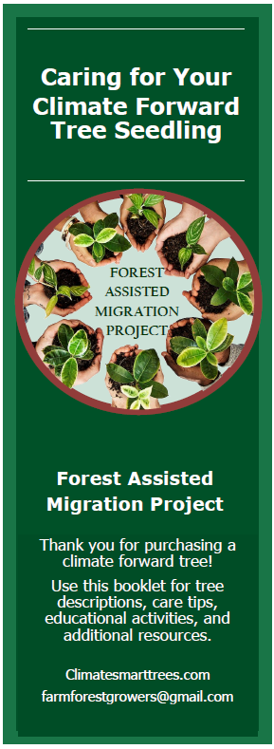
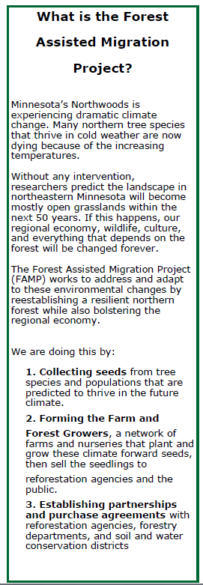
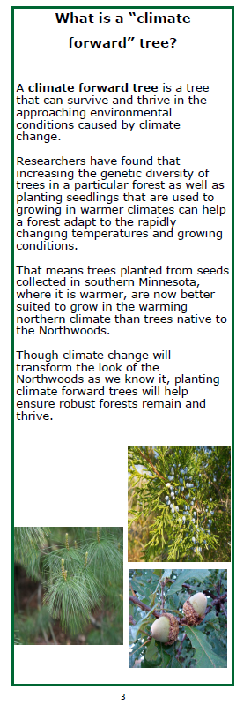
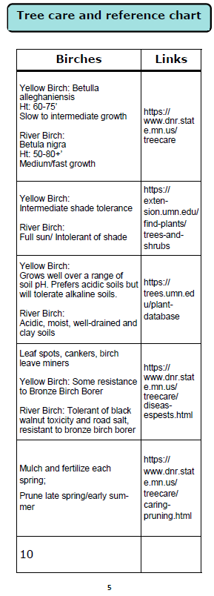

Slide 8
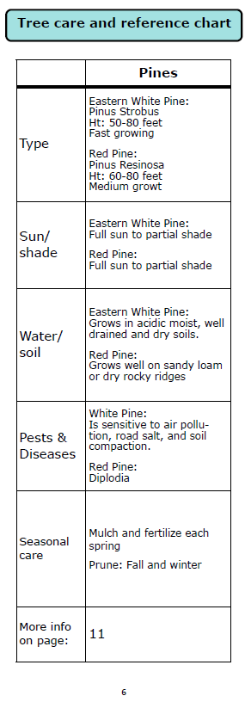
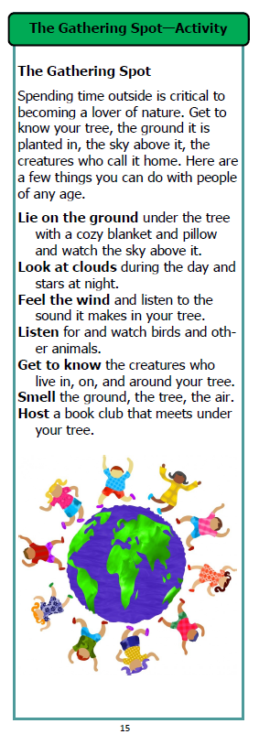
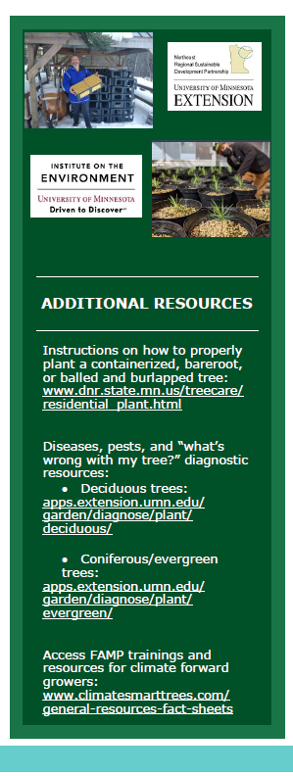

Slide 9
Thank you
Kaitlyn Egan
Katie Taubel
Terri Drimel
Lisa Janowiec
Arlene Flancher

